Slide 1



Partner Language Training Center Europe
(PLTCE)
at
George C. Marshall European Center for Security Studies
English for Security Professionals:
Maximizing Authenticity in the Classroom
By
Peggy Garza
Roxane Harrison

Slide 2
Partner Language Training Center Europe
(PLTCE)
at
George C. Marshall European Center for Security Studies
Overview
Background
  PLTCE-College Cooperation
English Language Enhancement Course (ELEC)
  Course syllabus and materials
  Impact
Authenticity

Slide 3

George C. Marshall Center
A German-American Partnership
Founded in 1993

Slide 4

The mission of the Marshall Center, as a vital instrument of German-American cooperation, is to create a more stable security environment by advancing democratic institutions and relationships; promoting active, peaceful, whole-of-government approaches to address transnational and regional security challenges; and creating and enhancing enduring partnerships worldwide.

Slide 5


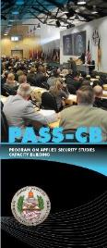

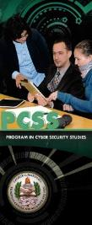
Courses for
Security Professionals
College of International and Security Studies
Six graduate-level courses for security professionals
Different content areas
  Course on Counter-Terrorism (CT) called
  Program on Terrorism and Security Studies (PTSS)
PASS
Program on Applied Security Studies

Slide 6
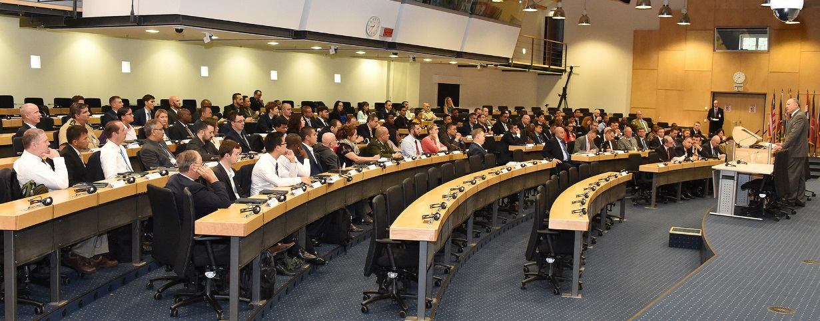
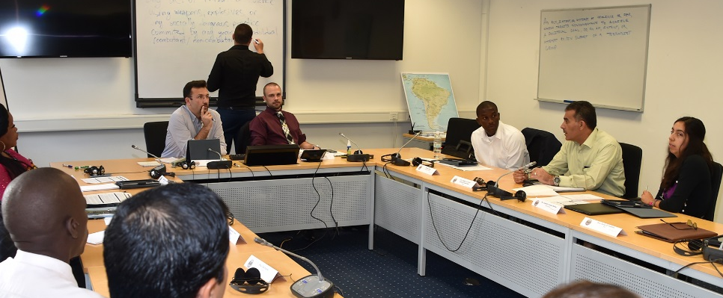
College CT Course Methodology
Presentations by professors and subject matter experts (SMEs)
Supporting readings
Daily seminars led by an academic and a practitioner
Exercises and simulations
Active learning

Slide 7
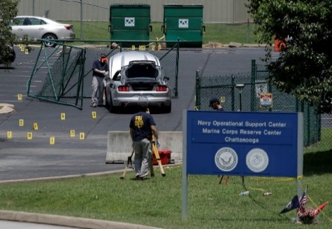

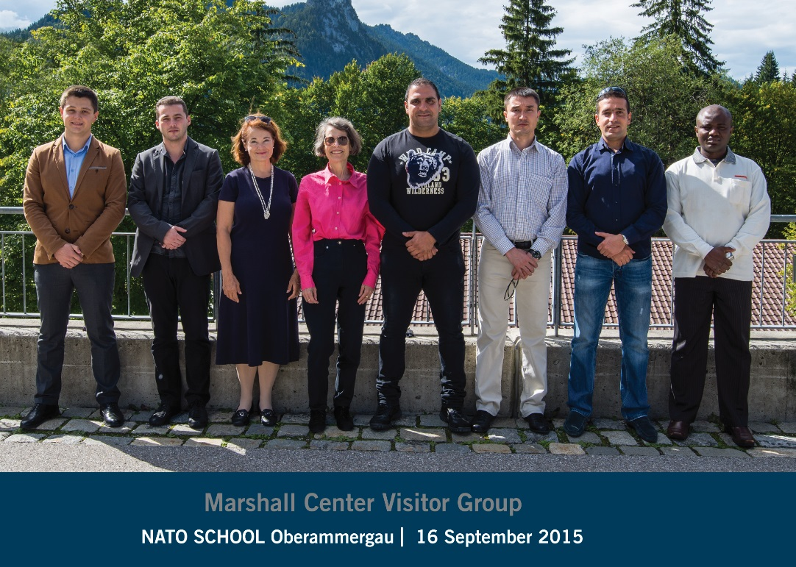
Need for a Language Enhancement Course
Overarching goal: to build a network of security professionals dedicated to the global mission of combating terrorism
Identified potential CT professionals who lack sufficient English

Slide 8
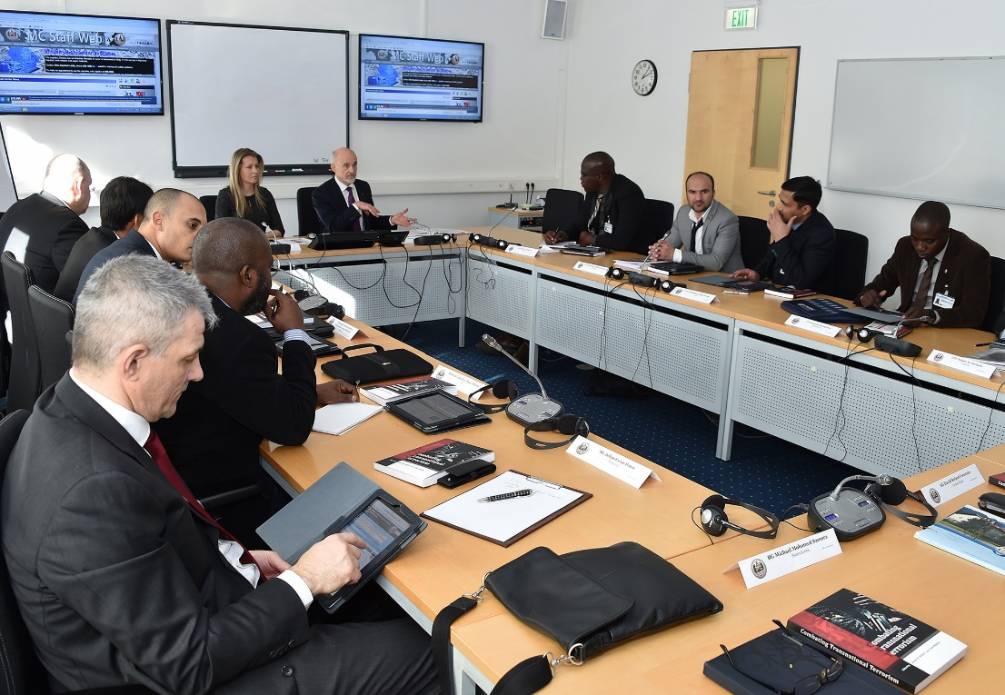
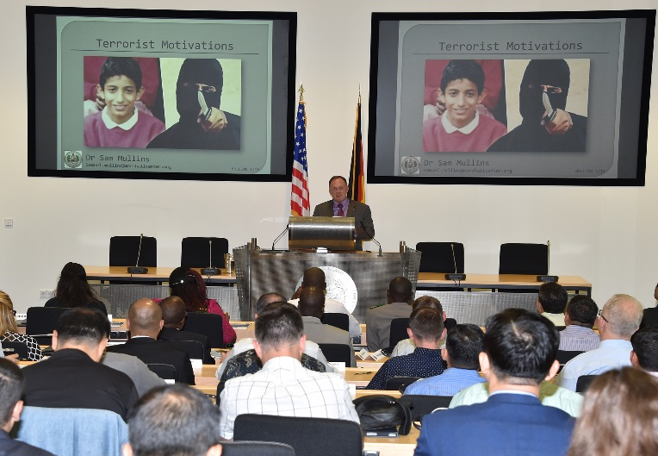
Language Demands in the College
CT Course
Comprehend lectures on technical subjects related to terrorism
Ask questions in a formal setting of professors and SMEs
Give a presentation on a strategy for combating terrorism
Participate in highly interactive seminar discussions
Read critically and analyze articles on topics in CT

Slide 9
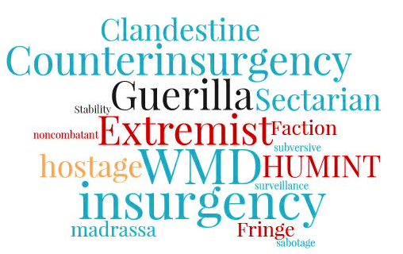
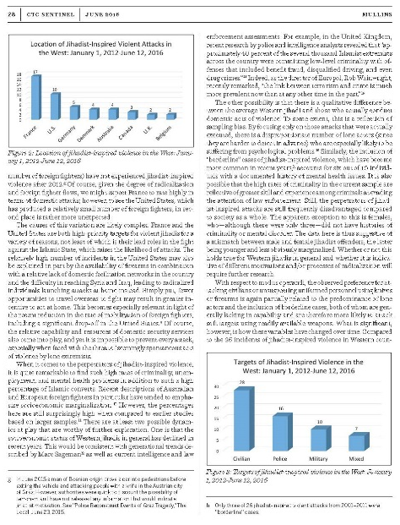
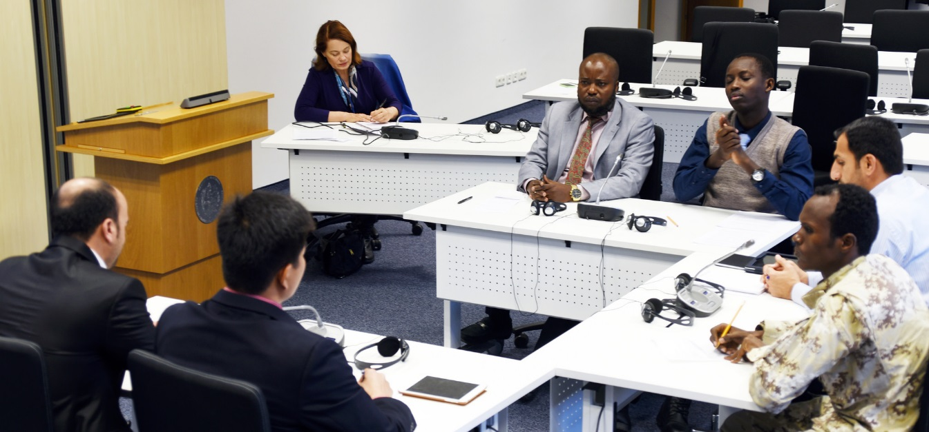
English Language Enhancement Course (ELEC) for CT Professionals
  Objectives
    Develop and practice professional presentation skills
    Acquire the specialized terminology of security studies and combating terrorism
    Enhance oral communication for more effective discussions on issues in security
    Sharpen analytical reading, listening, and writing skills using authentic source materials

Slide 10
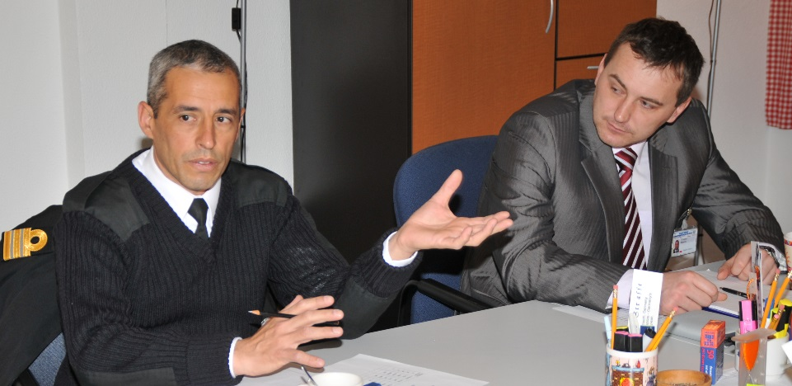
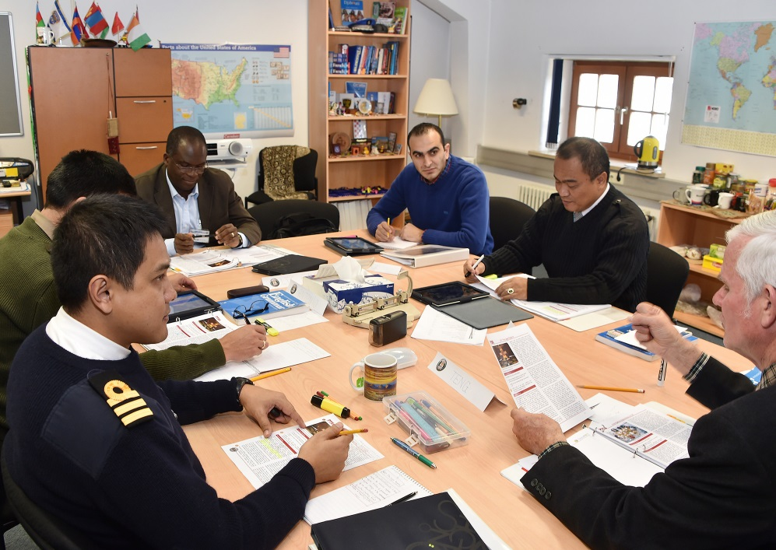
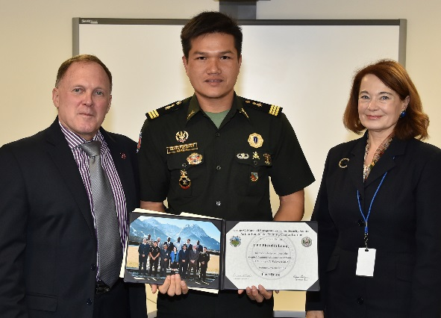
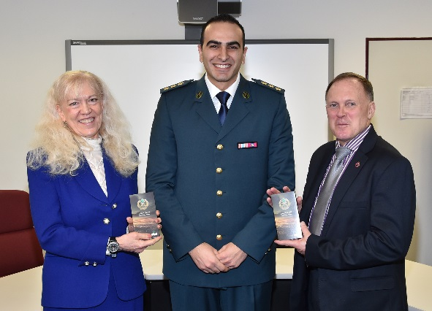
Our Model
Five weeks
Small class size
Language prerequisites
Competent teachers
Aim – support the College

Slide 11
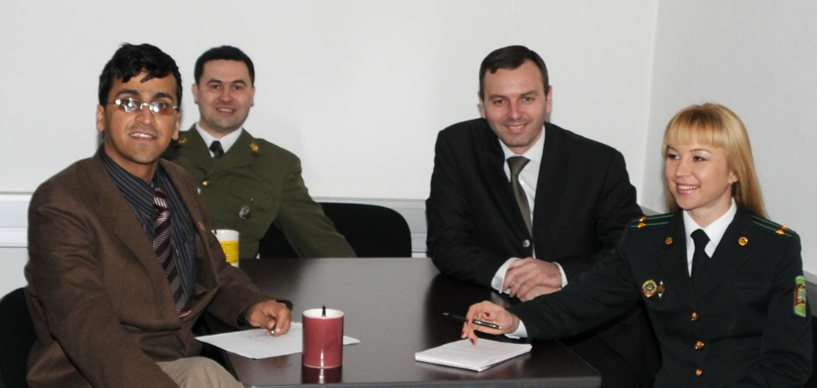
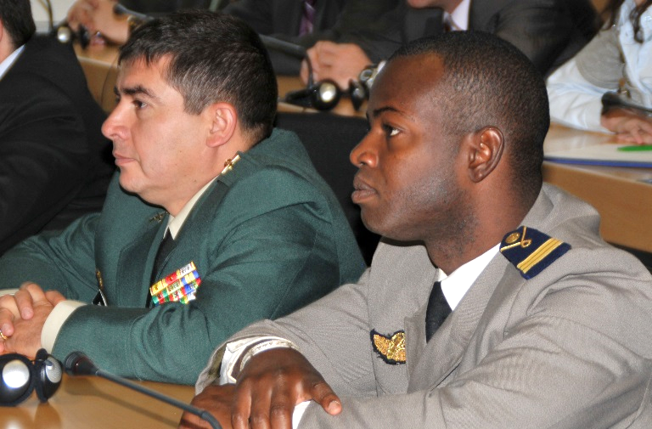
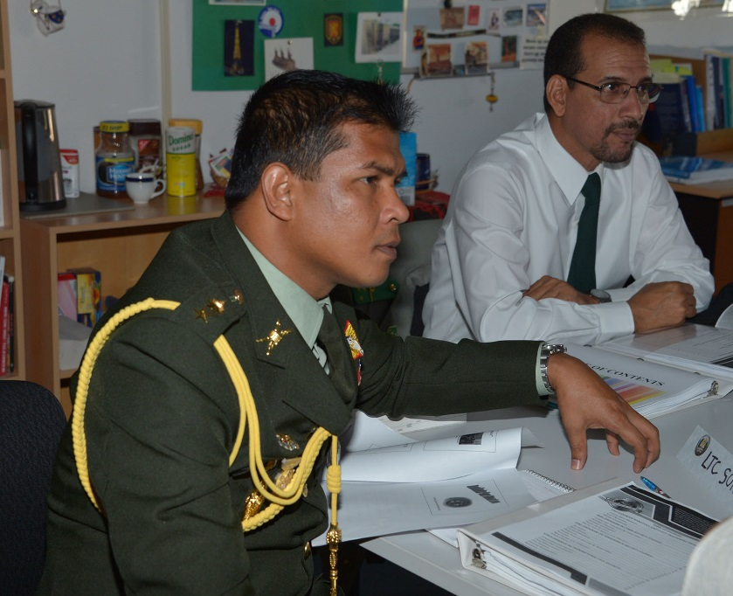
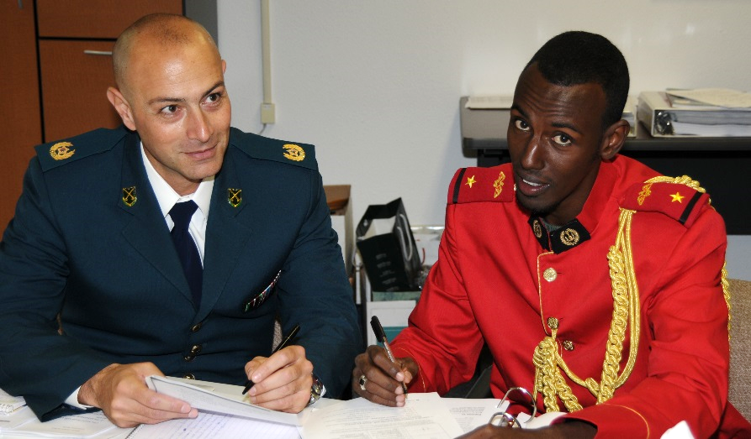
Profile of our Students
CT professionals and practitioners
Examples
  Military, law enforcement, intelligence analysts
Nations in 2016
  Europe: Bulgaria, Estonia, Moldova, Ukraine
  Sub Sahara Africa: Burkina Faso, Cote d’Ivoire, Djibouti, Mali, Togo
  Middle East: Lebanon, Morocco, Oman
  Far East: Cambodia, Indonesia, Japan, Thailand
  Central Asia: Afghanistan, Mongolia
  Latin America: Colombia, Peru

Slide 12


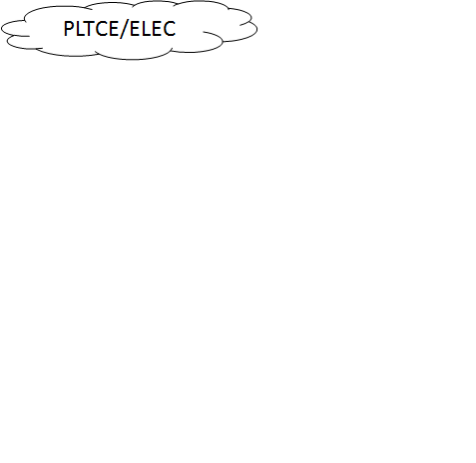


PLTCE-College Cooperation
College Course Director and faculty members are involved at different stages
  Planning
  During course delivery
  Course completion
College
PLTCE/ELEC

Slide 13
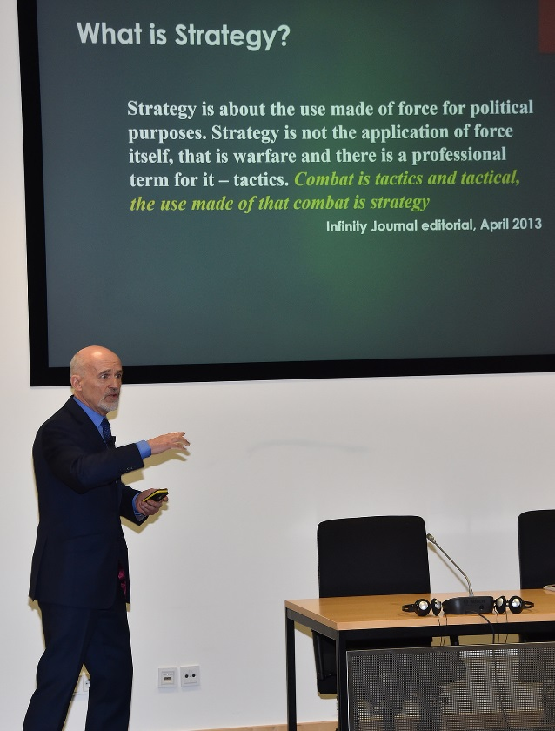
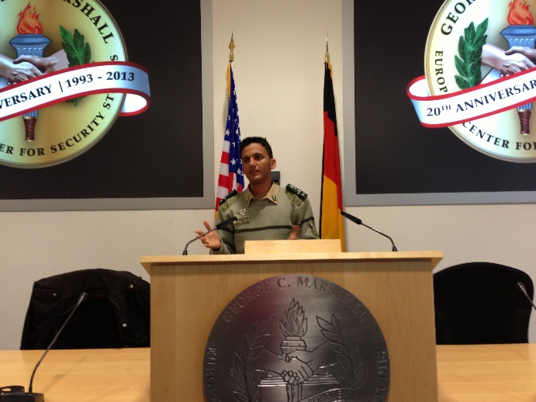
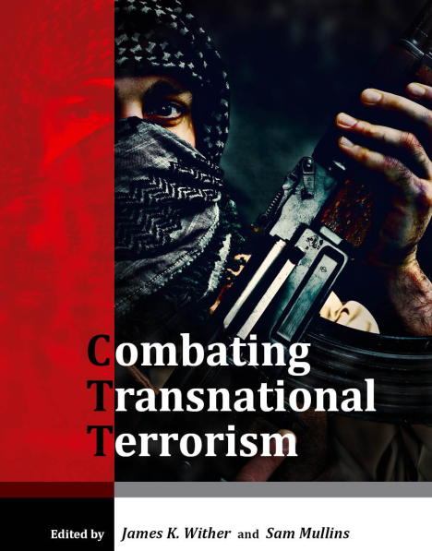
Authenticity
Authentic lectures
Authentic tasks
Authentic readings

Slide 14
ELEC Course Syllabus
Mirrors CT course syllabus
  Decelerated pacing
  Driven by language objectives and needs of students
  Scaffolding provided for language learning, practice, recycling of new language and growth
Flexible
  To tailor instruction to needs of participants
  To enable scheduling of guests
  To address needs of all stakeholders
    Research Library
    GlobalNet and Alumni Office

Slide 15
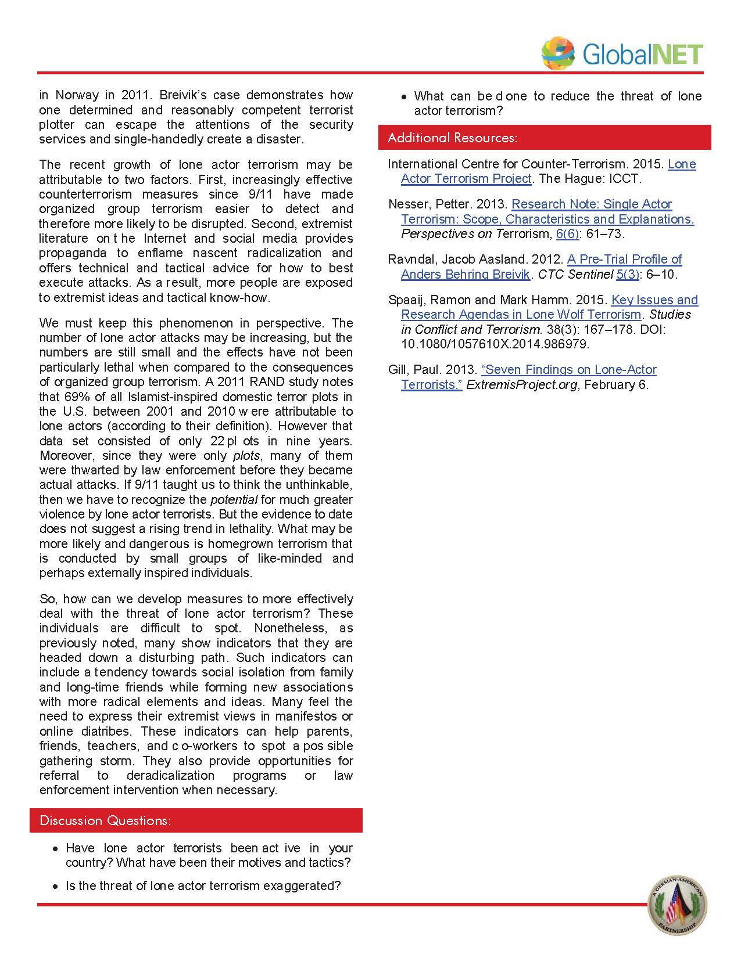
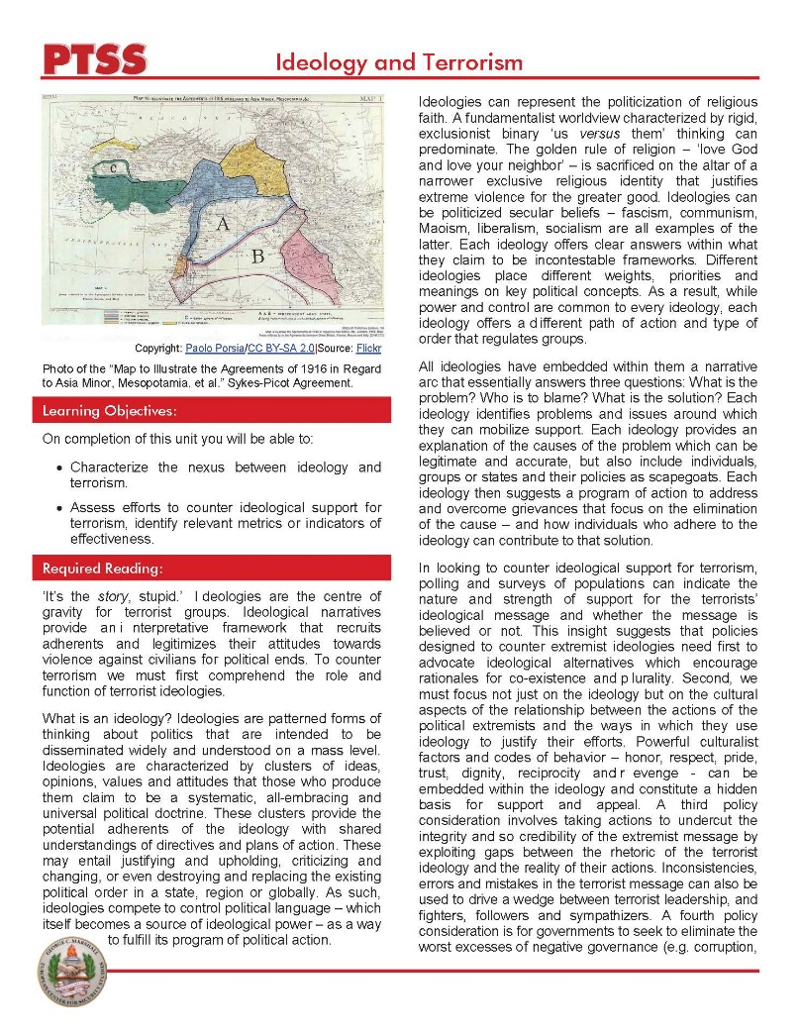
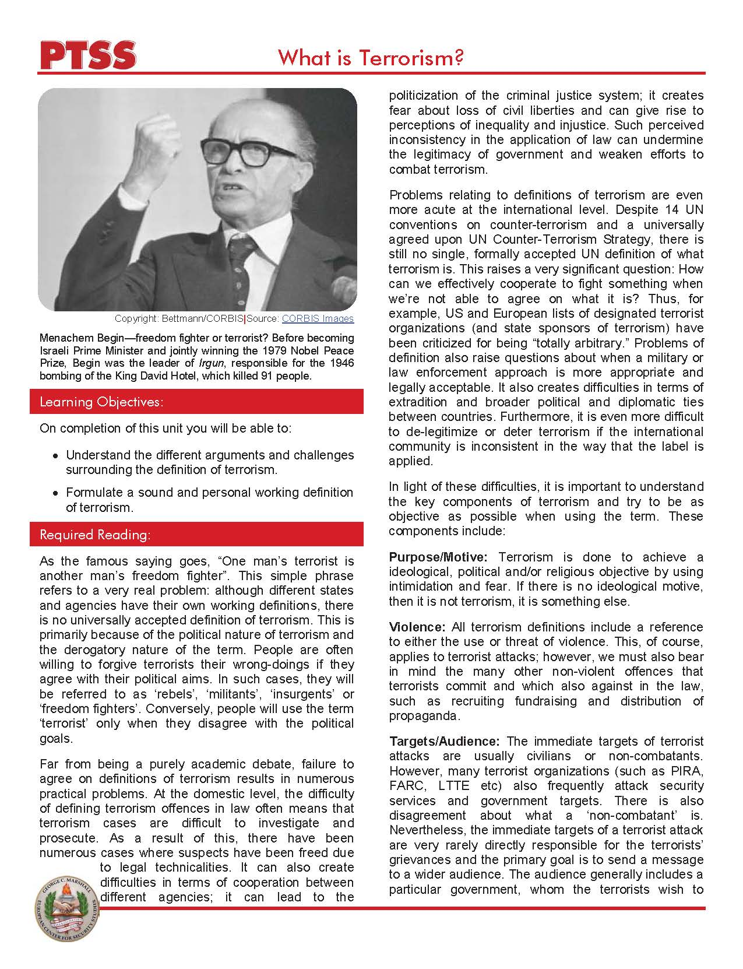
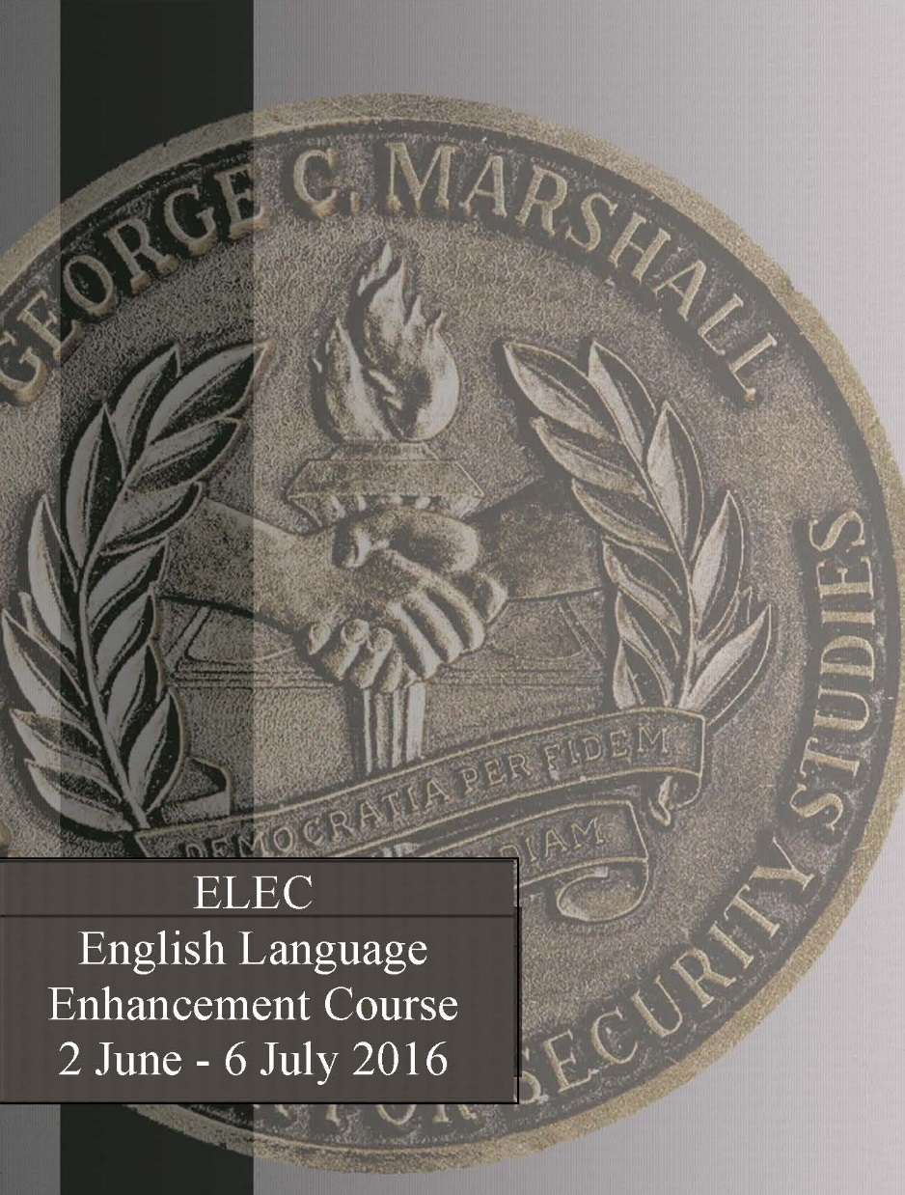
ELEC Course Materials

Slide 16
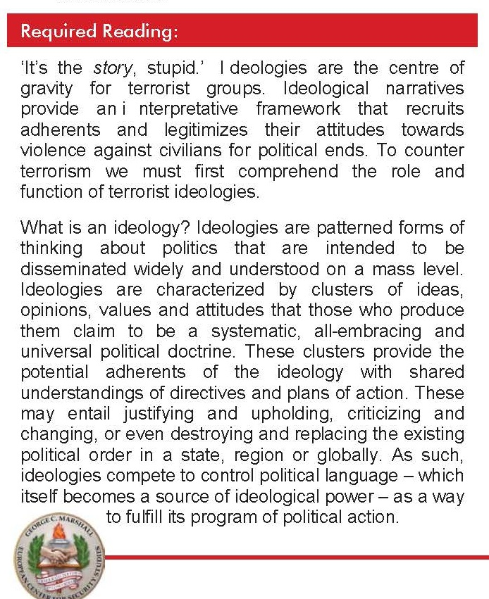
Specialized Vocabulary Instruction
Course Objective: Acquire the specialized terminology of security studies and combating terrorism
Vocabulary in context
  Pre-teaching vocabulary
  Supplying synonyms for unknown words from context
  Word families
  Collocations
  Student driven enquiries

Slide 17

Recycling Vocabulary
Activities that require use of target vocabulary throughout course
  Seminar style discussions
  Guest lectures
  Reading assignments
  SSS and elevator speaking practice with feedback in class
  Homework

Slide 18
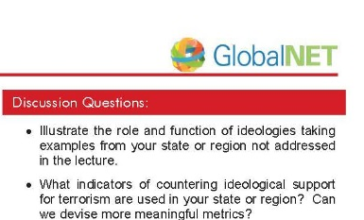
Developing Confidence in Speaking Skills
Course Objective: Enhance oral communication for more effective discussions on issues in security

Slide 19
Developing Confidence in Speaking Skills
SSS Approach to Speaking for Strategic Purposes:
Statement
  Give your opinion in a simple sentence.
Support
  Give reasons for your beliefs.
Summary
  Give the listener your message once again. This reinforces your opinion and leaves the listener with your message clearly in mind.
Course Objective: Enhance oral communication for more effective discussions on issues in security

Slide 20
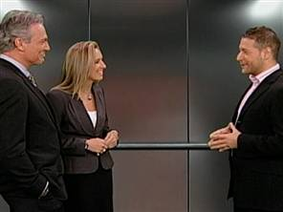
The Elevator Speech
Course Objective: Enhance oral communication for more effective discussions on issues in security
Focus on effective communication of content
Convey a message clearly and concisely in a form which reaches your audience
express important information under time pressure
convey ‘decision quality’ information in a brief period of time.
You are in an elevator with a decision maker you want to talk to. The elevator ride lasts 30 seconds.
Give this person important information – get your main point across, provide support for it, and leave a positive impression on your listener.

Slide 21
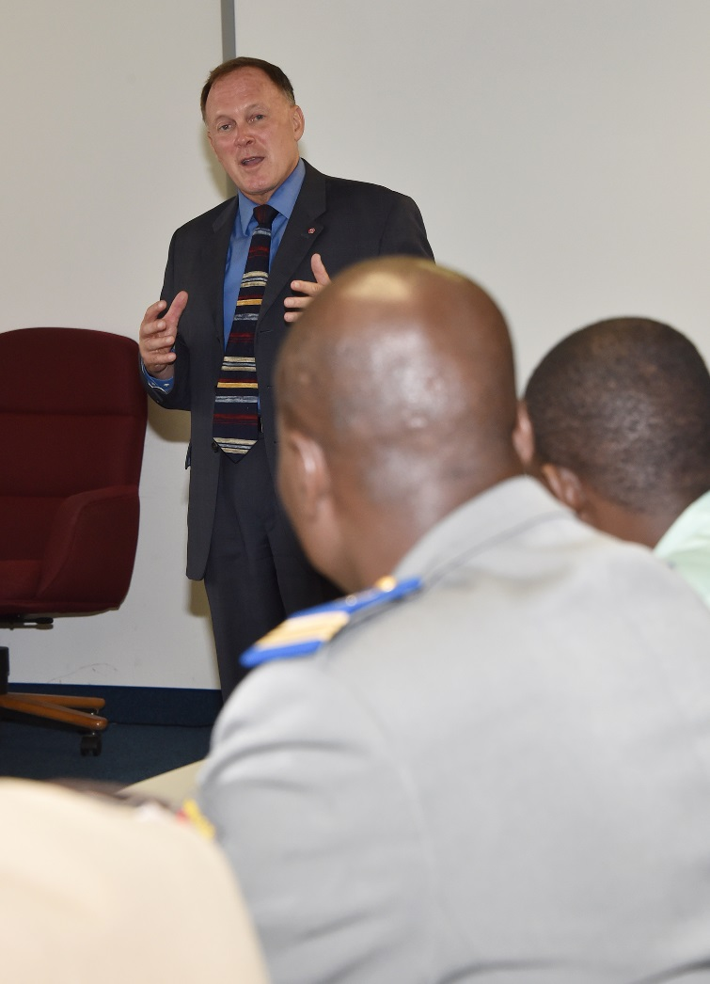
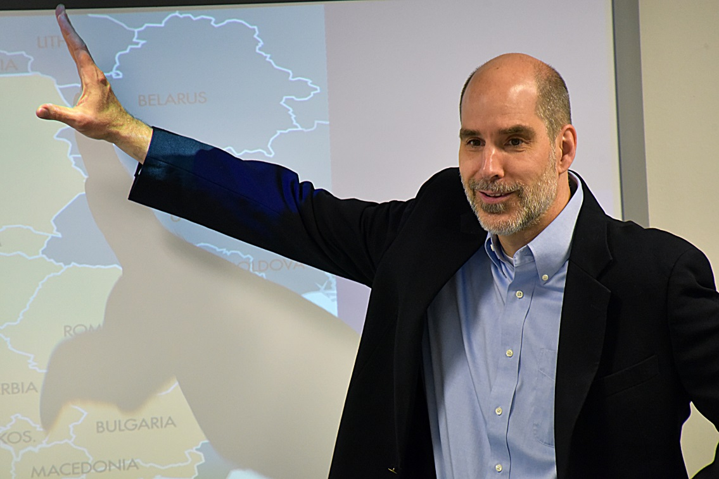
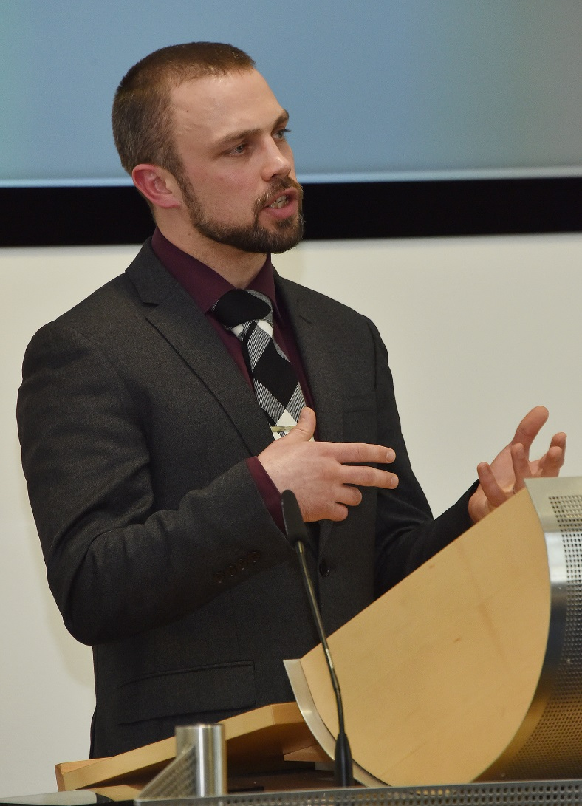


Guest Lecturers
Course Objective: Sharpen analytical reading, listening, and writing skills using authentic source materials

Slide 22
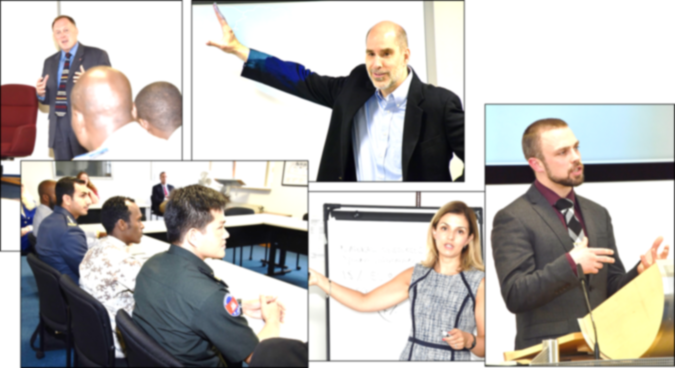
Developing Listening Skills through In-person Lectures
Recycle new vocabulary
Accustom ear to different regional accents
Preview CT Content
Preview different presentation styles of GCMC professors
Opportunity to synthesize personal experience with information from class reading and content from lectures
Formulate and pose relevant, timely and well-formed questions

Slide 23
Links to Current Reading

Slide 24
Integrated
Skills and Content
Objective: Sharpen analytical reading, listening, and writing skills using authentic source materials
HOMEWORK ASSIGNMENT:
Oral and written summary of a news item
As homework, find a news report concerning terrorism, or a security issue in general, from anywhere around the globe.
Be prepared to give a two-minute oral summary of the news item in class. In addition, send an e-mail to your instructor with a one-paragraph summary of the news item.
We will use this exercise to focus on speaking and writing skills as well as vocabulary and grammar.

Slide 25
Pushing the Level:
Toward Abstract Communication with Critical Thinking
Defining concrete events and tying them to broader, more abstract concepts
Hypothesizing and speculation
Differentiating between fact and opinion – in both receptive and productive communication
Describing trends and statistics
Creating and posing thoughtful and relevant questions in both formal and semi-formal environments

Slide 26
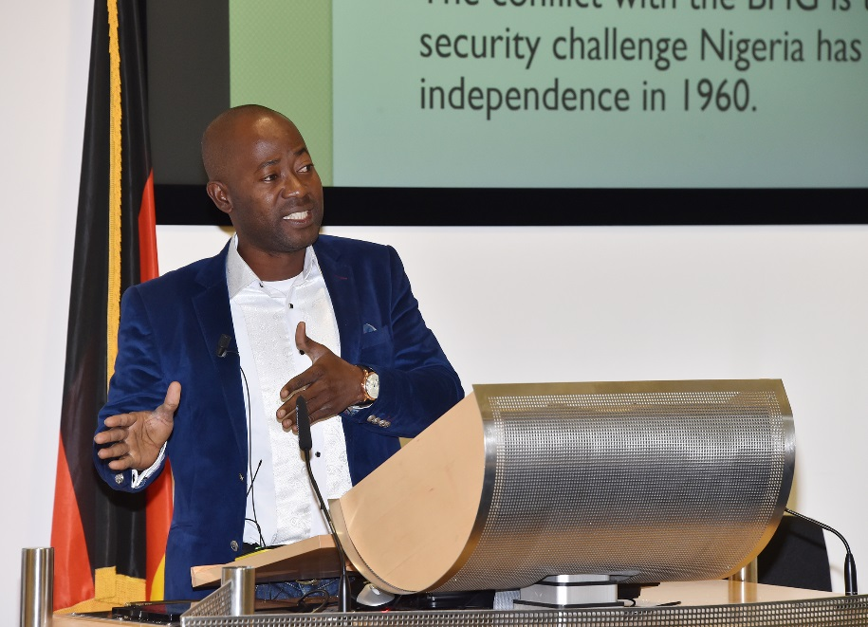
Capstone projects – mirror CT course projects
Panels
Presentations
Discussions
Video recorded twice
Feedback on first and second ‘performance’
Participants keep recordings

Slide 27
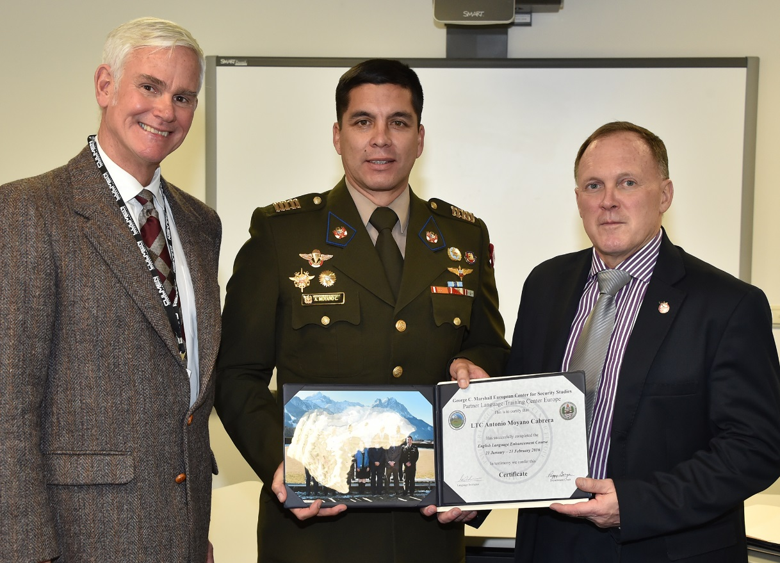
Impact - Student Participants
Have greater confidence
Have a head start on course content
Improved language skills
Understanding and use of specialized vocabulary
Prepared for course projects
Formed strong & lasting bonds with fellow ELEC participants

Slide 28
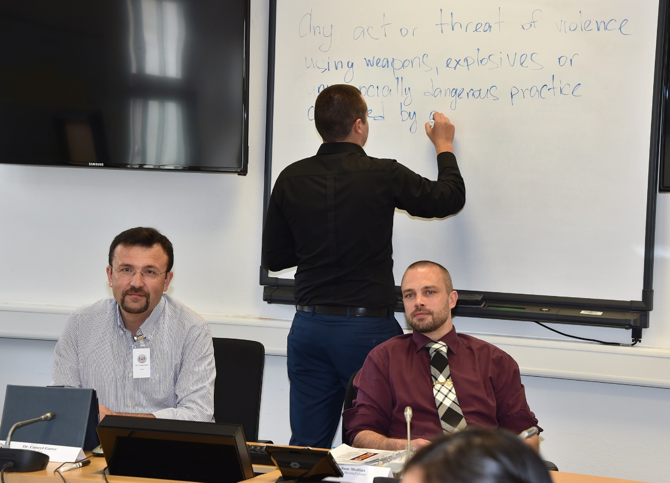
Impact - College / Course Director
ELEC participants lead the way on CT courses
Already oriented to college
Have a head start on course content
Break the ice by speaking up
Ask good questions in plenary
Get seminar discussions started
Help / guide / advise peers with newcomer issues

Slide 29
Comments or Questions?
Thank you for your attention.
CONTACT:
English Language Enhancement Courses
Partner Language Training Center Europe (PLTCE)
at the George C. Marshall European Center for Security Studies
Garmisch-Partenkirchen, Germany
Peggy Garza, Department Chair – garzap@marshallcenter.org
Roxane Harrison, Program Manager – roxane.Harrison@marshallcenter.org

